Slide 1

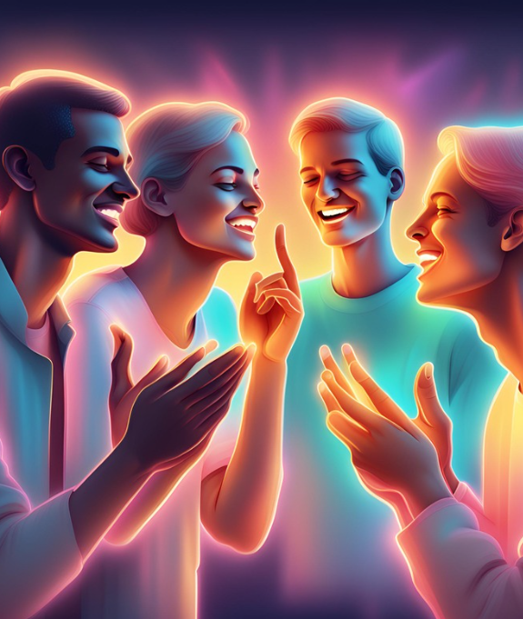
SIGN LANGUAGE
RECOGNITION
Md-DS1-10-23
Hrynkevich Aliona

Slide 2


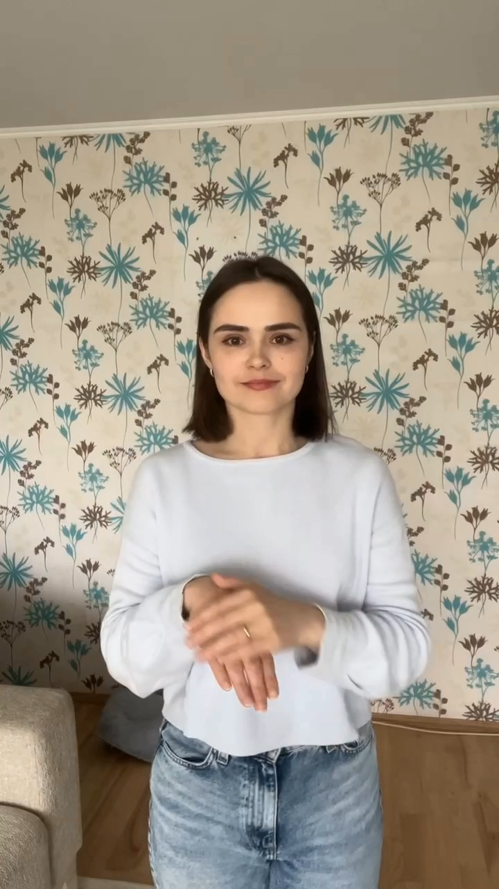
INTRODUCTION
Sign language recognition is especially relevant for: healthcare facilities, banks, educational institutions, train stations, hotels.
The number of deaf people is about 70 million people in the world or 0.1% of the population.
There are more than 138 national sign languages ​​in the world, and they are all different.
There are separate gestures for letters, individual words, and phrases. Hands, facial expressions, and body position are involved in performing gestures
Currently, sign language interpreters are working for communication between deaf and hearing people, but few organizations and institutions employ them.
Добрый день

Slide 3
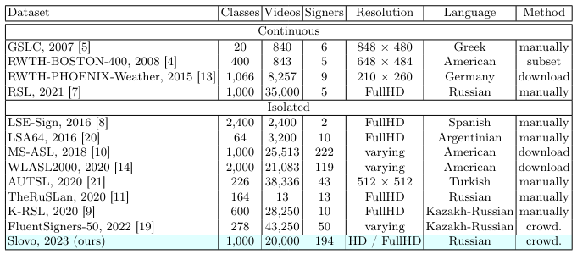
OTHER'S EXPERIENCE
DATASETS
MAIN APPROACHES
Development of a new neural network architecture specifically for studying sign language and training
Fine tuning of pre-trained deep neural networks for sign language recognition
Using classical ML models and simple neural networks to recognize sign language based on key points

Slide 4
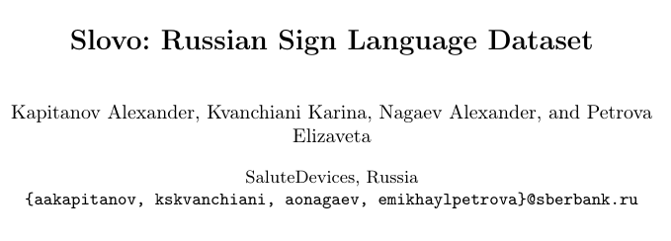
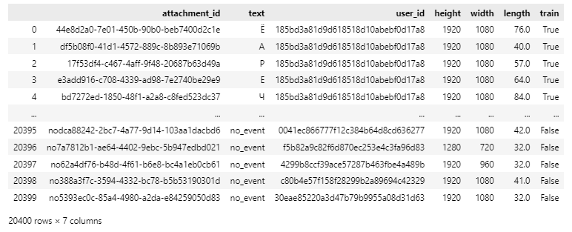
DATASET-1001 CLASSES
Dataset size: 20,400 videos
Number of classes: 1001 classes (1000 gesture classes + 1 no_event class)
Number of videos per class: 20 videos for each gesture + 400 Videos per class no_ events
Unique people on video: 194
Video quality: HD/Full HD
Sign language: Russian
Availability of division into training and testing: yes
Distribution of samples between train & test: uniform (15 train samples, 5 tests samples per class)
Dataset weight: 16 GB
https://arxiv.org/pdf/2305.14527 [12 Mar 2024]
ANNOTATION

Slide 5
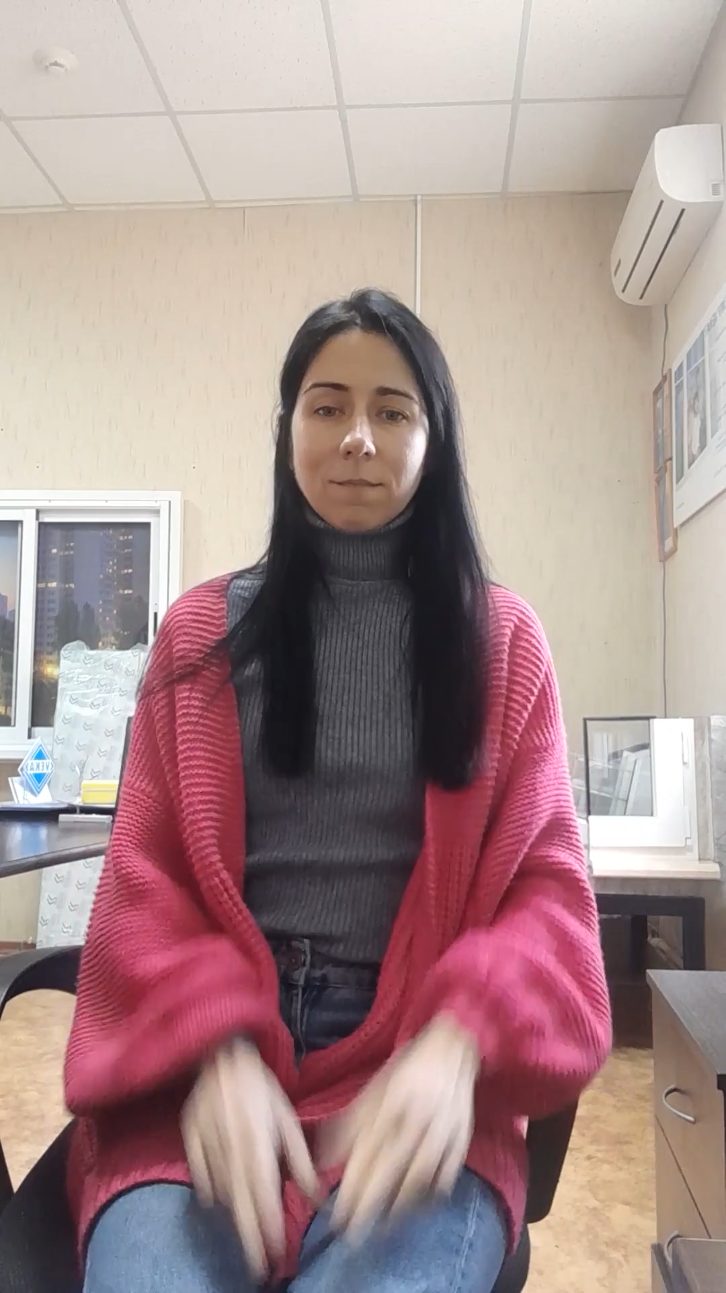
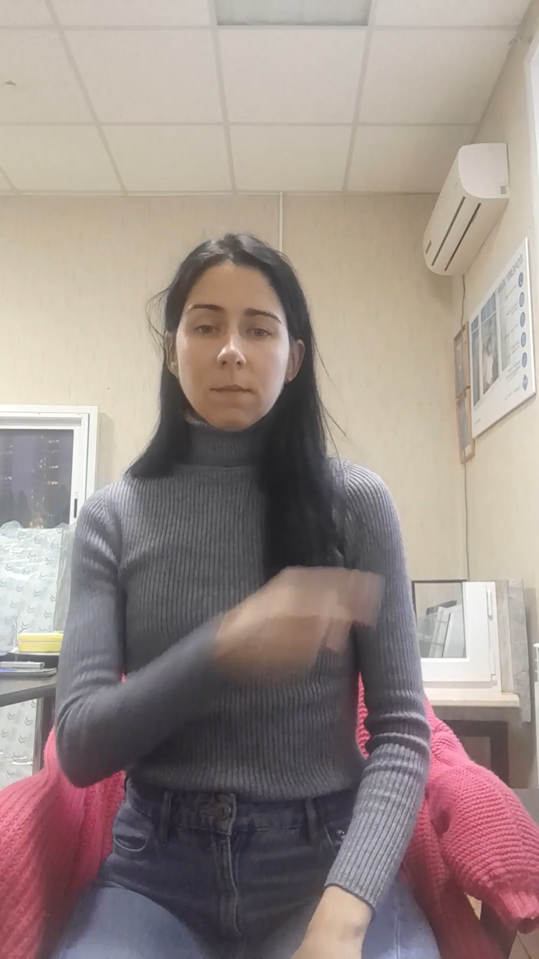
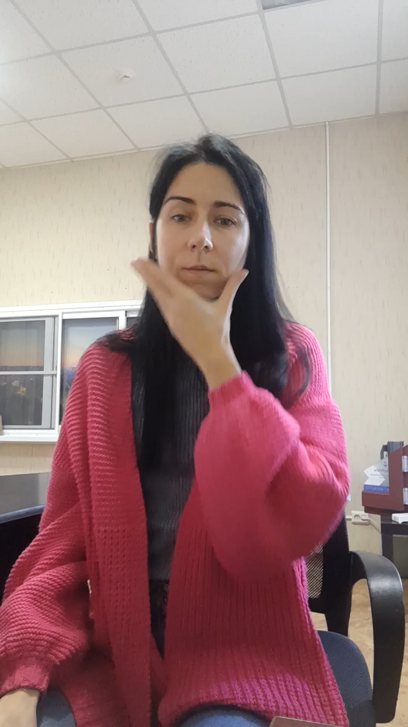
DATASET-1001 CLASSES
Счастливый
Сильный
Красивый

Slide 6

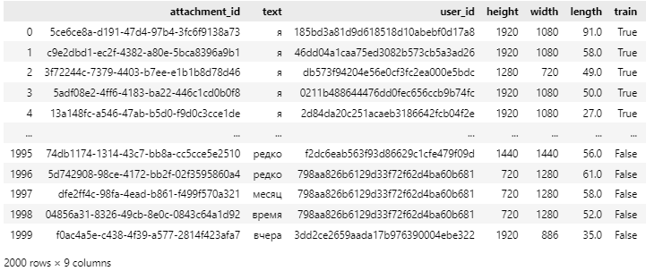
SUBDATASET-100 CLASSES
CLASSES
Dataset size: 2000 videos
Number of classes: 100 classes
Number of videos per class: 20 videos for each gesture
Unique people on video: 194
Video quality: HD/Full HD
Sign language: Russian
Availability of division into training and testing: yes
Distribution of samples between train & test: uniform (15 train samples, 5 tests samples per class)
Dataset weight: 1,4 GB
main_gestures = [“привет", "пока", "да", "не", "благодарность", "я", "мать", "отец", "сын", "дочь", "сестра", "брат", "ребёнок", "жена", "муж", "мужчина", "женщина", "семья", "меня", "тебя", "мне", "ты", "тебе", "ваш", "утро", "день", "ночь", "год", "месяц", "сегодня", "завтра", "вчера", "редко", "часто", "немного", "много", "больше", "тёплый", "холодный", "деньги", "цена", "дом", "работать", "школа", "магазин", "комната", "время", "дорога", "собака", "кошка", "попугай", "птица", "рыба", "дикое животное", "домашнее животное", "красный", "оранжевый", "желтый", "зелёный", "синий", "фиолетовый", "черный", "белый", "серый", "бежевый", "Золото", "серебро", "кто?", "что", "что-нибудь", "когда", "который", "вода", "еда", "болит", "нуждаться", "хотеть", "иметь", "быть", "любить", "ждать", "купить", "найти", "нравиться", "говорить", "позволить", "помочь", "терять", "добрый", "агрессивный", "расстроенный", "напуганный", "счастливый", "сильный", "недобрый", "красивый", "резервирование; бронирование", "кафетерий", "женский туалет", "мужской туалет"]
ANNOTATION

Slide 7
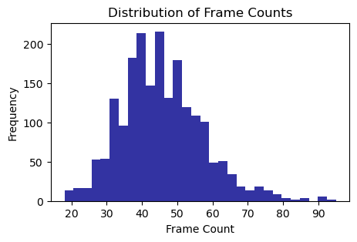
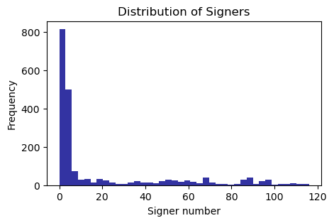
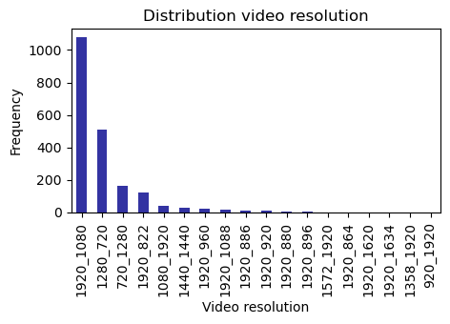
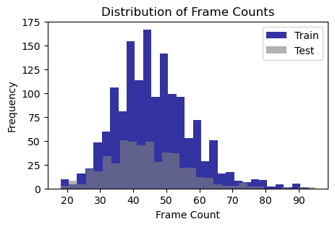
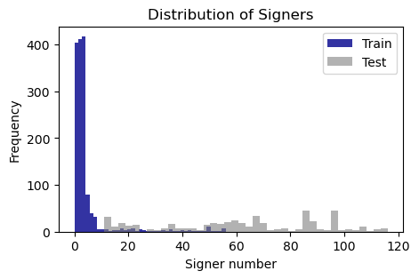
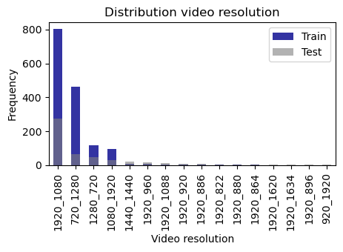
EXPLORATORY DATA ANALYSIS

Slide 8
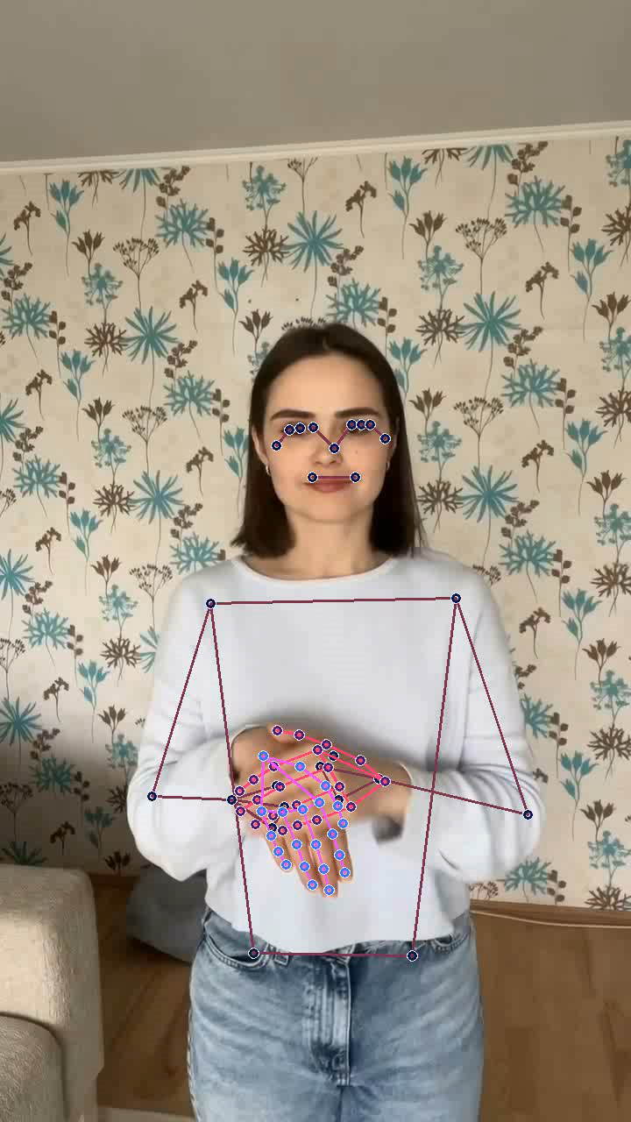
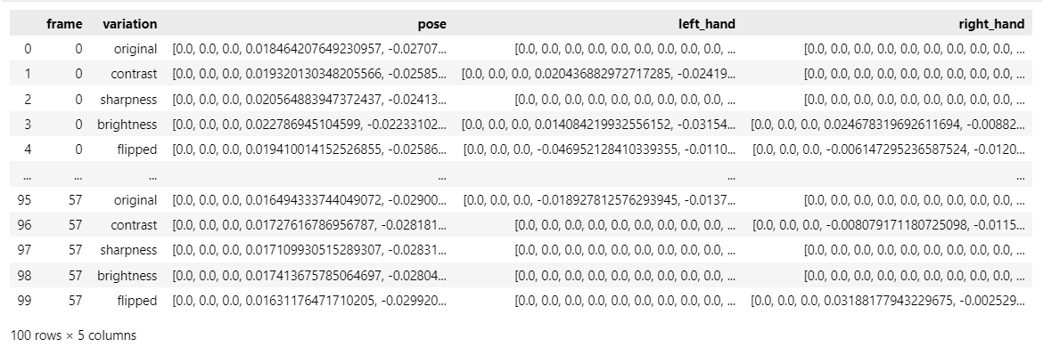
TRAINING
Steps:
Step 1: Find key points for 20 frames from each video using MediaPipe (from Google Research).For each frame, 3 vectors of length 225 are returned (pose, left hand, right hand)
Step 2. Feeding key points into the model and training to predict the class of the gesture
The following models took part in the training:
Classic ML models: SVM, Naive Bayes classifier, Logistic Regression, Random Forest,
Simple neural networks: Vanilla NN, LSTM Model, CNN1D Model, Transformer Model.
Добрый день

Slide 9

Original + Flipping
Original
EXPERIMENTS WITH FRAMES
PURPOSE OF LIFE
Original + Augmentation
Original + Flipping + Augmentation

Slide 10
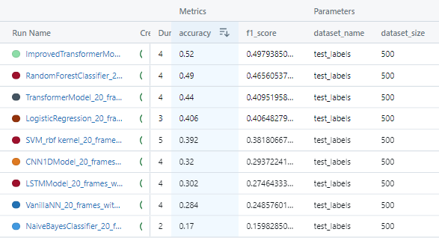
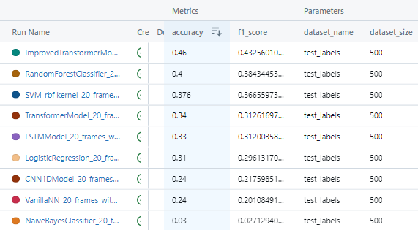
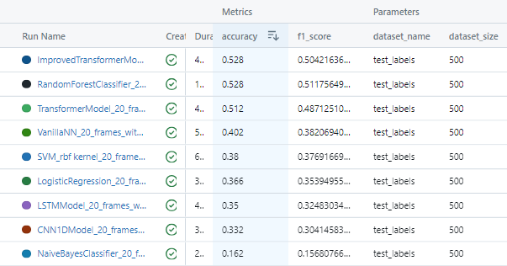
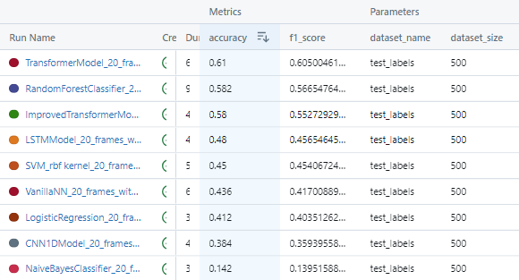
APPROACH 2| Experiment results
Original
Original + Flipping
Original + Augmentation
Original + Flipping + Augmentation

Slide 11
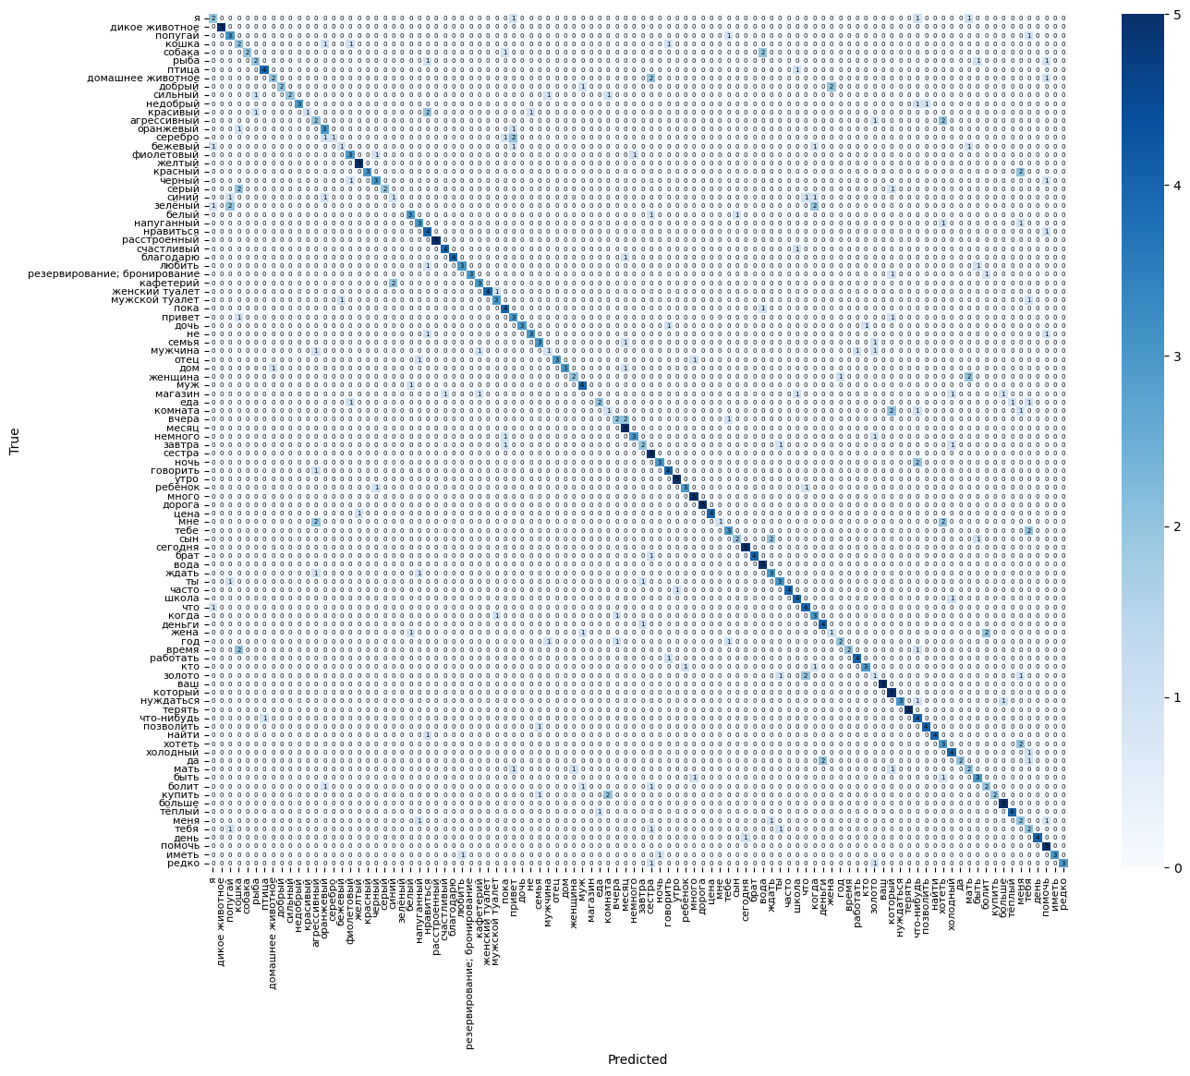
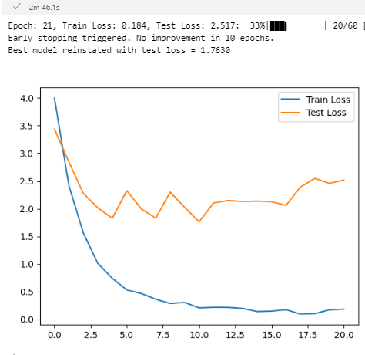
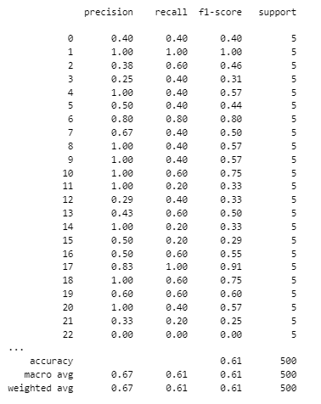
APPROACH 2| BEST MODEL RESULTS
Best model: Transformer model (2 encoder layers, 5 heads, 128 dim feedforward)
Metrics: Accuracy 0.61, F1 score: 0.61
Confusion matrix
Loss function dynamics, best value 1,7630
Classification report

Slide 12
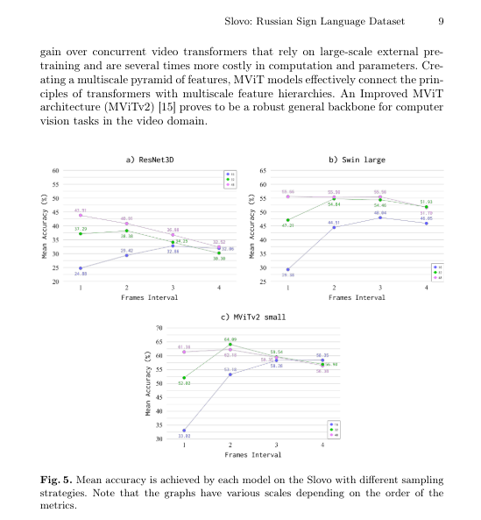
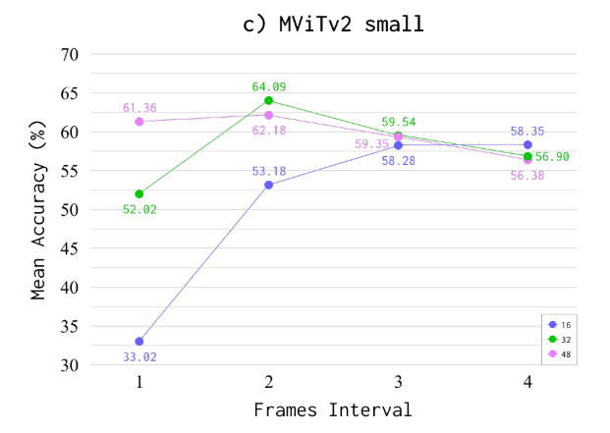
BEST METRICS FROM ORIGINAL PAPER
Approach 2| VIA Key points
https://arxiv.org/pdf/2305.14527 [12 Mar 2024]

Slide 13
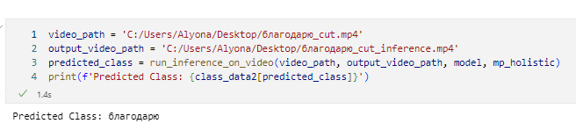
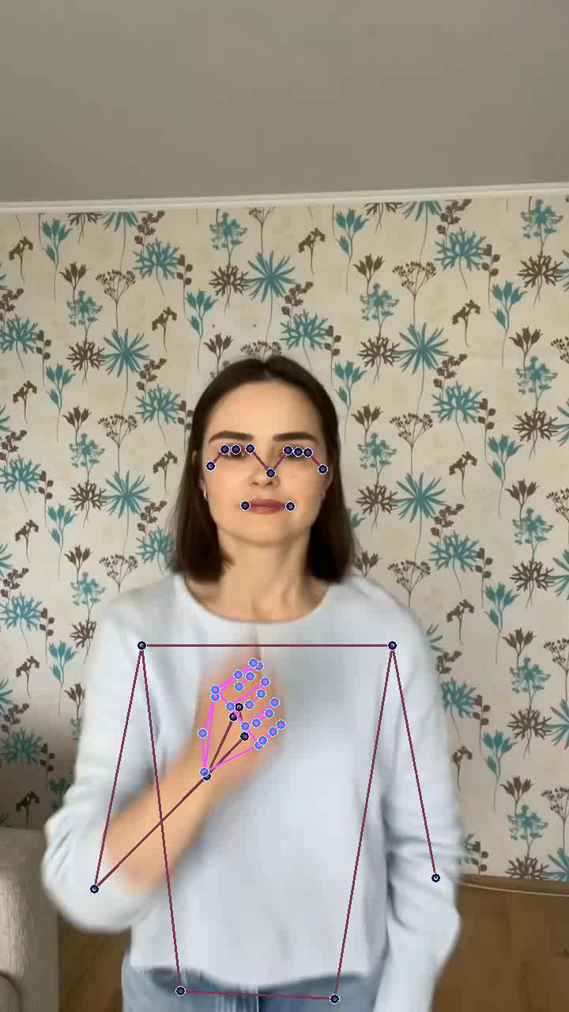
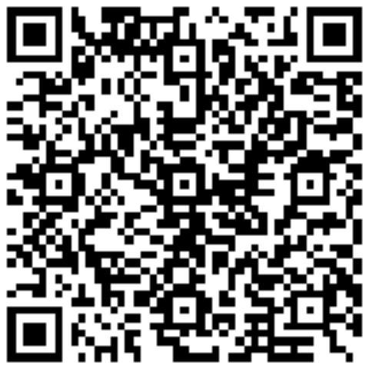

INFERENCE
CONTACTS
Hrynkevich Aliona
Email Address
hursikalena@mail.ru
LinkedIn
Telegram
Благодарю

